Slide 1
ANDROID BASED REMOTE PROGRAMMABLE SEQUENTIAL
By R.Harika M.Kranthi kumar P.Sindhuja

Slide 2
Contents
Introduction
Embedded System
Android application
Block diagram
Hardware Requirements
Software Requirements
Working
Advantages
Applications

Slide 3
Introduction
In industries, there are many tasks that are carried out which requires some repeated operation in various orders and time intervals. For example, certain loads need to be switched ON/OFF in specific time intervals.
Generally PLC’s are used for such cases.

Slide 4
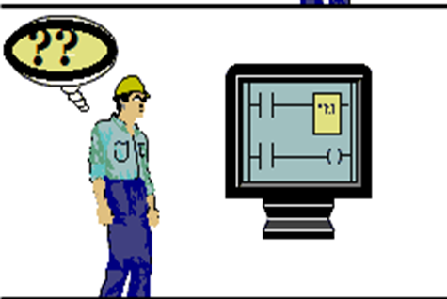

But when we consider simple operations…. PLCs would be a disadvantage when programming, hardware ,cost and complexity are considered.
So a simple and easily operated solution is needed which is of less cost and which involves the latest technology….
ANDROID BASED REMOTE
PROGRAMMABLE SEQUENTIAL

Slide 5
This project is designed to switch industrial loads using a user programmable logic control device and Android application for sequential operation.
Remote operation is achieved by any smart-phone/Tablet etc., with Android OS, upon a GUI (Graphical User Interface) based touch screen operation.

Slide 6
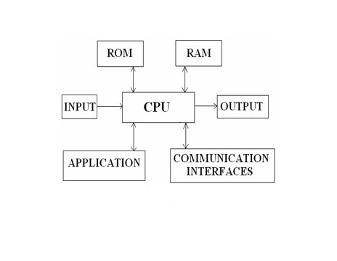
Embedded Systems
A combination of hardware and software which together
form a component of a larger machine.An embedded system is designed to run on its own without human intervention, and may be required to respond to events in real time.

Slide 7
Android and its application
Android is an open-source operating system.
Android is built on the open Linux Kernel.
It is Very customizable.
Open source operating system is easily changed, hacked, manipulated, and molded to fit whatever functionality you had in mind.
Found on all platforms for all prices depending on what hardware and software version you are interested in.

Slide 8
What is an android application on mobile phones?
An android app is meant for phones with an android based operating systems.
In our project we are using Blue Control app

Slide 9
ANDROID APPLICATION OPERATED BLUETOOTH
The Android platform includes support for the Bluetooth network stack, which allows a device to wirelessly exchange data with other Bluetooth devices.
The application framework provides access to the Bluetooth functionality through the Android Bluetooth APIs.

Slide 10
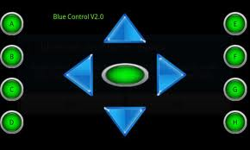
An example of Android App Blue-control Screen

Slide 11
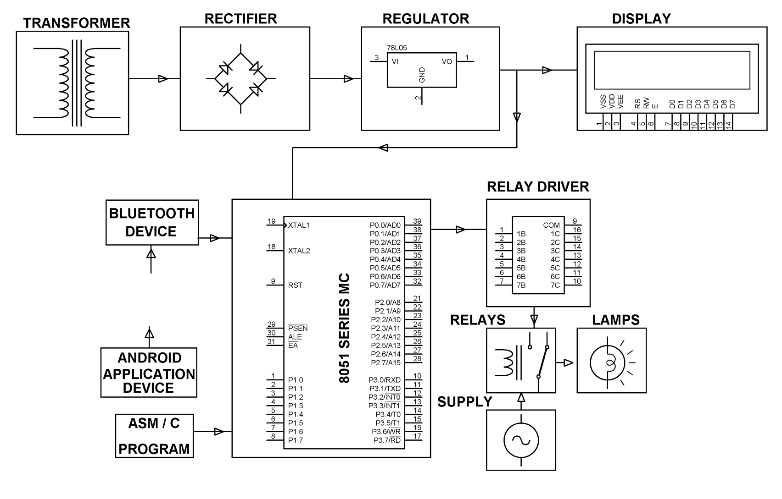
BLOCK DIAGRAM

Slide 12
Hardware Requirements
8051 series Microcontroller
Bluetooth Device.
LCD, Relay Driver, Relays.
Resistors, Capacitors, LEDs.
Crystal, Diodes.
Transformer, Voltage Regulator.
Lamps.

Slide 13
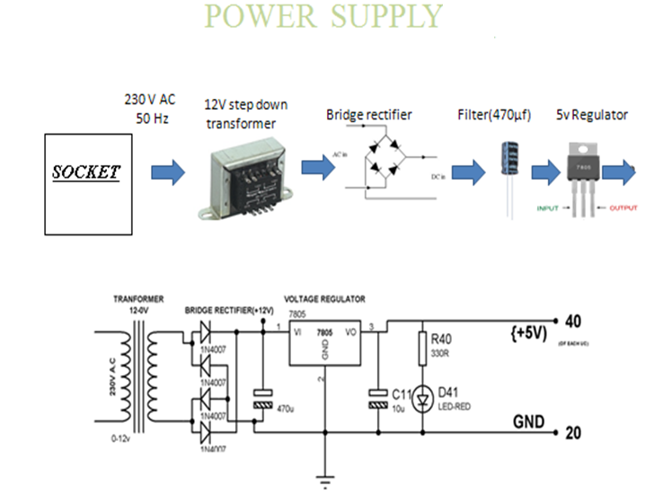

Slide 14
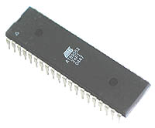
MICRO CONTROLLER
Compatible with MCS®-51 Products
8K Bytes of In-System Programmable (ISP) Flash Memory
4.0V to 5.5V Operating Range
Crystal Frequency 11.0592MHZ
Three-level Program Memory Lock
256 x 8-bit Internal RAM
32 Programmable I/O Lines
Three 16-bit Timer/Counters
Eight Interrupt Sources
Full Duplex UART Serial Channel
Watchdog Timer
AT89S52

Slide 15
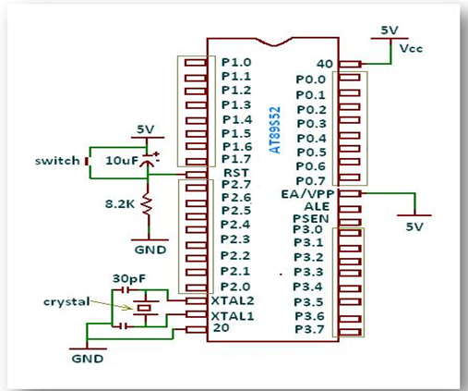
PIN DIAGRAM OF AT89S52

Slide 16
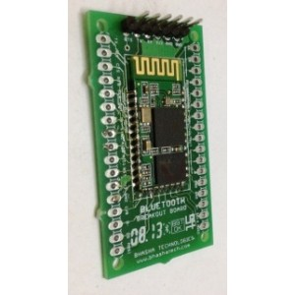
FEATURES OF BLUETOOTH
Super simple and easy way to interface using Bluetooth stack.
3.3V Device with standard 5V DC Power source.
Can also support SPI Protocol, pins are made available.
Low power consumption, Low cost.
Has high-performance wireless transceiver system
Can be used to interface with PC, Mac or Android phones/tablets.
Generic Default Visibility at Software side:HC-06 or Linvor
Default Pairing code is not '0000' but '1234'.
Works with any microcontroller with Serial connectivity.

Slide 17
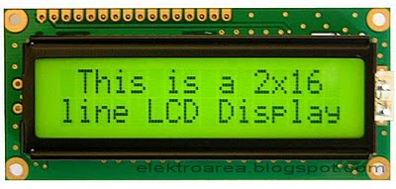
LIQUID CRYSTAL DISPLAY (LCD)
Most common LCDs connected to the microcontrollers are 16x2 and
20x2 displays.
This means 16 characters per line by 2 lines and 20 characters per line
by 2 lines, respectively.
The standard is referred to as HD44780U, which refers to the controller
chip which receives data from an external source (and communicates
directly with the LCD.

Slide 18
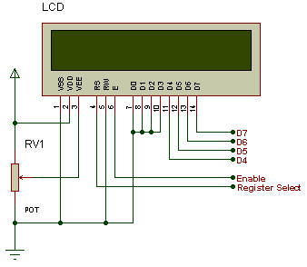
LCD BACKGROUND
If an 8-bit data bus is used the LCD will require 11 data lines
(3 control lines plus the 8 lines for the data bus)
The three control lines are referred to as EN, RS, and RW
EN=Enable (used to tell the LCD that you are sending it data)
RS=Register Select (When RS is low (0), data is treated as a command)
(When RS is High(1), data being sent is text data )
R/W=Read/Write (When RW is low (0), the data written to the LCD)
(When RW is high (1), the data reading to the LCD)

Slide 19
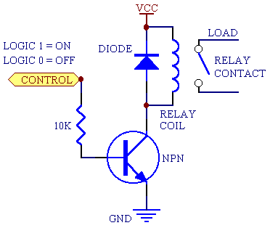
RELAY
It is an electromagnetic test.
Used to control the electrical devices.
Copper core magnetic flux plays main role here.

Slide 20
Relay Driver ULN2003
ULN is Relay driver application
The ULN2003 is a monolithic high voltage and high current Darlington transistor arrays.
It consists of seven NPN Darlington pairs that features high-voltage outputs with common-cathode clamp diode for switching inductive loads.
The collector-current rating of a single Darlington pair is 500mA.
The Darlington pairs may be paralleled for higher current capability.

Slide 21
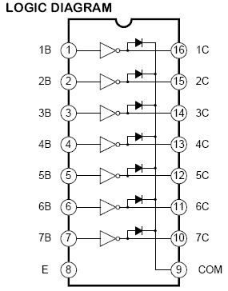
The ULN functions as an inverter.
If the logic at input 1B is high then the output at its corresponding pin 1C will be low.

Slide 22
SOFTWARE REQUIREMENTS
PROGRAMMING LANGUAGES
Embedded C , ALP (Assembly Language)
COMPILERS:
Keil 2.0/3.0uv
DUMPING SOFT WARE:
Using Micro controller flash Software we are dumping our HEX Code into Micro Controller

Slide 23
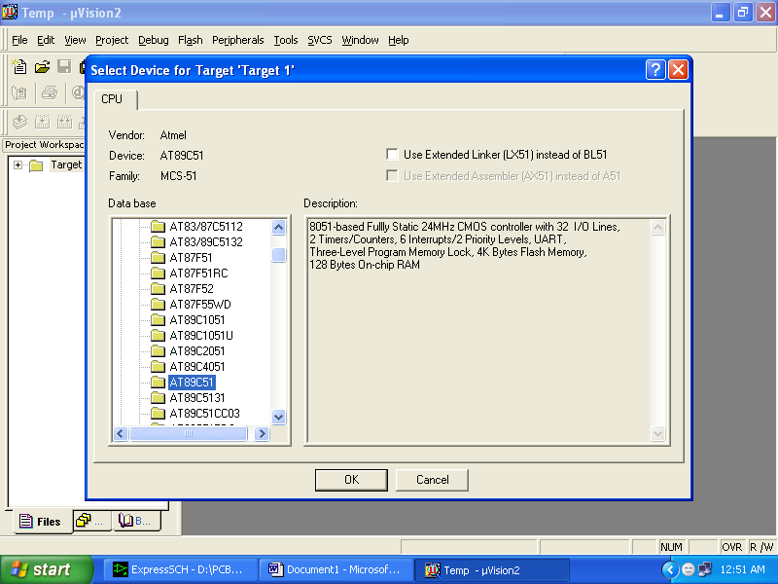
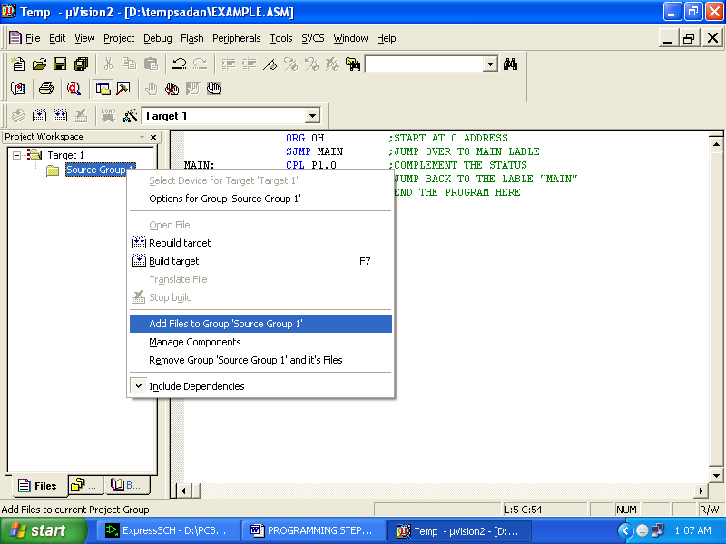
KEIL COMPILER WINDOW

Slide 24
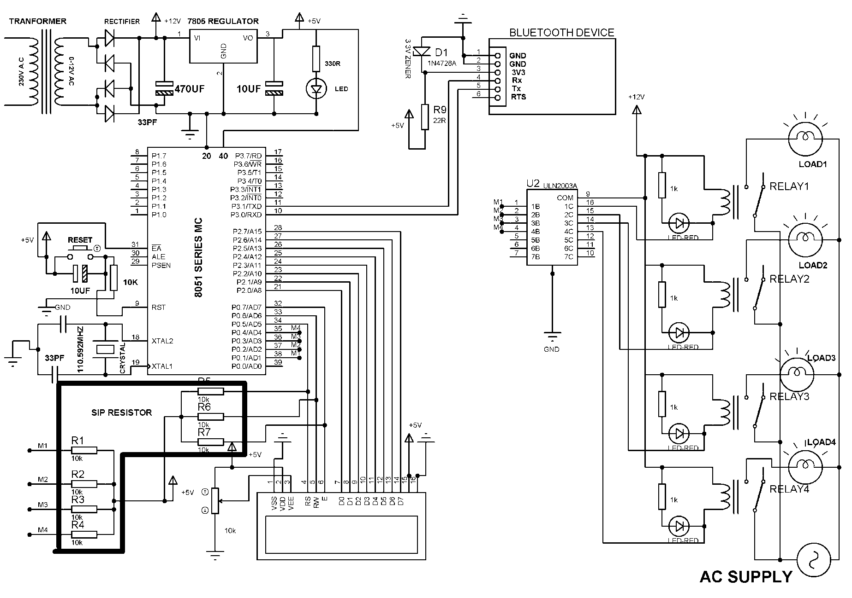
Schematic Diagram

Slide 25
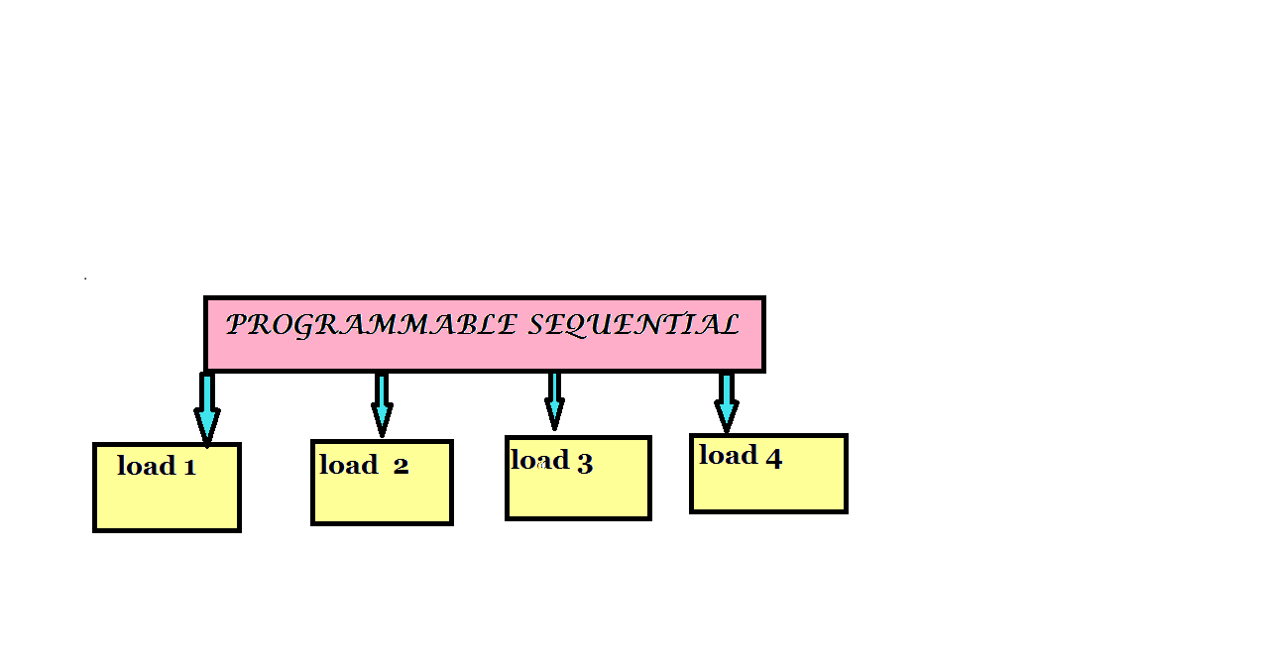
Applications
For small scale industries where the loads to be operated sequentially this will be a better option.

Slide 26
Advantages
Economical.
Easy to operate.
Small size.

Slide 27
THANK YOU

